Slide 1
Consolidated Trailers, Inc.
Corporate Capability Statement
Principal Names: Dale B. Cole Jr. & Mark C. Shoemaker
1851 Edison Highway
Baltimore, Maryland 21213-1527
Phone: 410-732-3230 Fax: 410-497-1036
Email: dale@consolidatedtrailers.com
Email: mark@consolidatedtrailers.com
GSA Contract #: GS-30F-0025R * HubZone Certified *
Veteran Owned * Small Business
FEIN: 52-1667450 * CAGE CODE 1URV4 * Duns #621705003

Slide 2
Consolidated Trailers Overview
Semi-Trailer Drive through repair & maintenance as well as structural modifications and collision damage. Great Dane factory authorized service.
Semi-Trailer Replacement Parts and accessories for Great Dane Trailers.
GSA Contract #GS-30F-0025R: New Great Dane semi-trailers including dry vans, refrigerated vans and platform trailers as well smaller enclosed cargo trailers manufactured by Wells Cargo.

Slide 3
1851 Edison Highway

Slide 4
Factory Authorized Service
C.T.I. has been providing semi-trailer repair services in the Baltimore/Washington area since 1990. Our ability to offer superior customer service is a direct result of our 20 plus years of experience along with our strategic location in Baltimore City and our long time affiliation with Great Dane Trailers. Our parts inventory provides our shop with most common items (swing door blanks, lock rods, aluminum panels, etc.) for fixing every day types of trailer damage. Non-stock items are normally available quickly through our Great Dane PDC.
With shop services including air brake system repair, aluminum welding, major body repair, life gates and FHWA inspections, we cover the entire spectrum of trailer repair.
Our company is very aware of the pressure that a Fleet is experiencing when a trailer is down in terms of dollars and cents issues related to delivering a load. Our people are fast and efficient in estimating the repair including digital photos of the damage if requested.
If your company is searching for a highly professional maintenance solution for your fleet, Consolidated is the answer in Baltimore, Maryland.

Slide 5
Semi-Trailer Bays

Slide 6
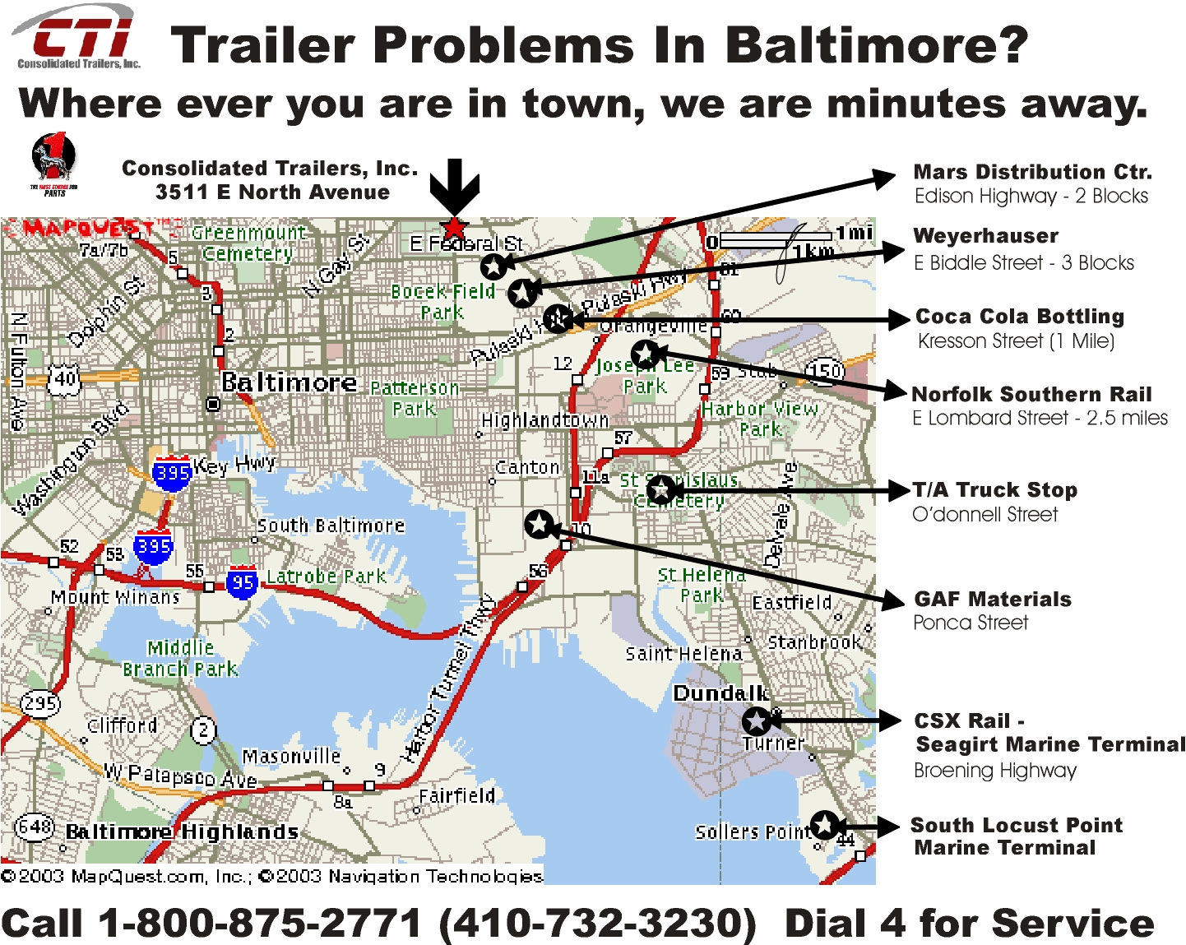
Our Location in Baltimore

Slide 7
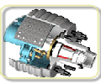
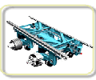
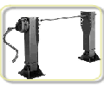
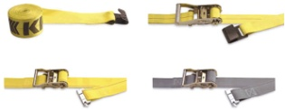
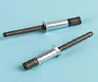
Semi-Trailer Parts & Accessories
Lights
Air Brakes
Chemicals
Axles
Electrical
Shoes
Suspensions
Legs
Cargo Control
Flooring
Brass
Fasteners
Swing Door
O/H Door
Body Parts

Slide 8
Product Line Sheet
AIR BRAKES COMPONENTS AIR CHAMBERS AND VALVES
BEARINGS, OIL SEALS, HUB CAPS BODY COMPONENTS - ALL MAKES & MODELS
BRAKE PARTS AND ACCESSORIES BRAKE SHOES AND HARDWARE KITS
BRASS FITTINGS CAMSHAFTS AND BRUSHING KITS
CHAIN AND BINDERS DOCK BUMPERS
DOCUMENTS HOLDERS ELECTRONIC PLUGS AND RECEPTACLES
FASTENERS FIFTH WHEELS
FIRE EXTINGUISHERS KING PINS AND KING PIN LOCKS
LANDING GEAR AND ACCESSORIES LIGHTS, MIRRORS AND REFLECTORS
LOAD LOCK BARS LOGISTICS E AND F TRACK, STRAPS AND BEAMS
MINIATURE LIGHT BULBS MUD FLAPS AND MOUNTING BRACKETS
OVERHEAD DOORS AND PARTS PAINTS AND SPRAYS
PINTLE HOOKS PLYMETAL DOORS, GASKET AND FRAMING
PLYWOOD SHEETS SIGNS, PLACARDS, DECALS
SIDE KITS AND ACCESSORIES TAPES, CAULKS, ADHESIVES, LUBES
TANK FENDERS AND COMPONENTS TARPS AND TARP SYSTEMS
TRAILER SPRINGS & SUSPENSIONS TWIST PINS AND COMPONENTS
WHEELS AND DRUMS WIRE AND WIRE CONNECTORS
WOOD FLOORING - OAK & APITONG

Slide 9
Parts Inventory / Warehouse

Slide 10
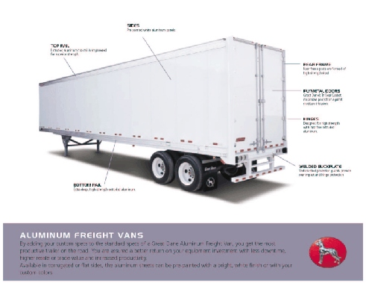
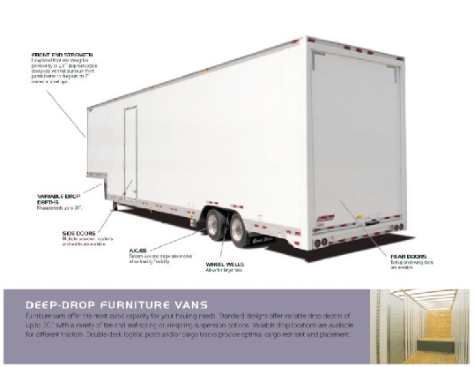
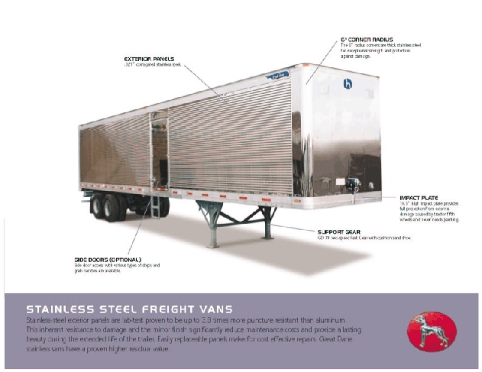
Great Dane Classic Vans
Government Sales
The Best Trailer Value Available.
All Great Dane Freight Van Designs Have Been Engineered To Meet Your Needs. These Designs Were Tested In The Industry’s Most Extensive R & D Lab And Then Road Proven In The Real World Before Becoming Available For Sale. Many Quality Features That Are Standard On Great Dane Vans Are Costly Options And In Some Cases Not Available From Other Manufacturers.

Slide 11
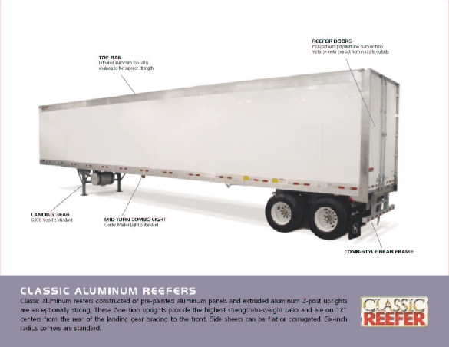
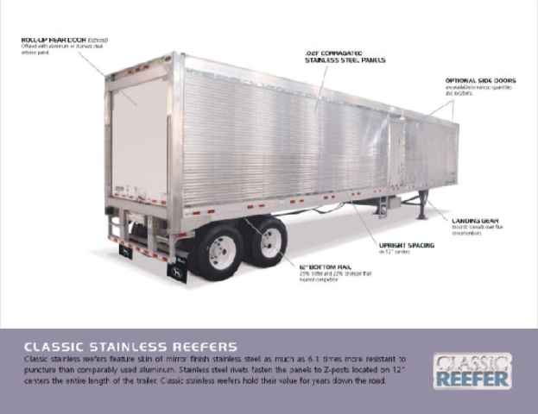
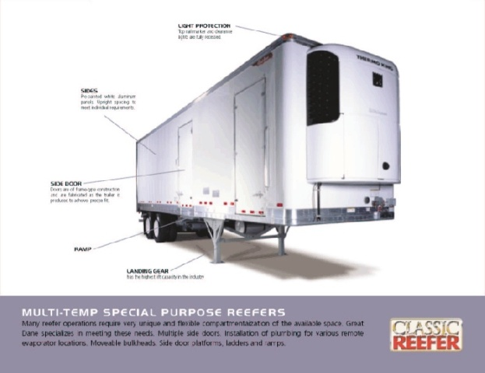
Great Dane Classic Reefers
Government Sales
The Best Just Keeps Getting Better
Great Dane Classic Reefers Represent The Best Equipment
Investment You Can Make. Innovative Designs And The Very
Highest Quality Standards Provide The Best Value In
Refrigerated Trailers Available. No Other U.S. Manufacture
Can Match Our Experience Or Track Record With
Refrigerated Semi-Trailer Equipment.

Slide 12
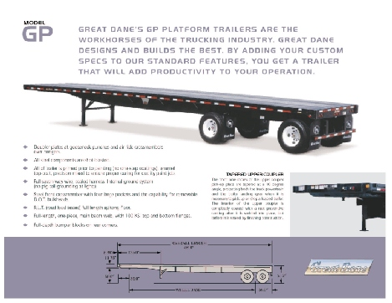
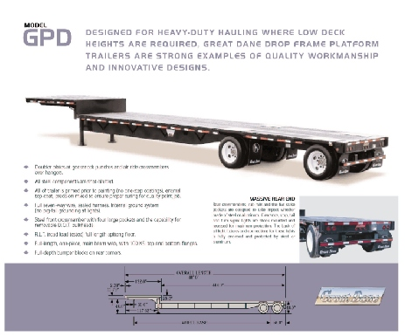
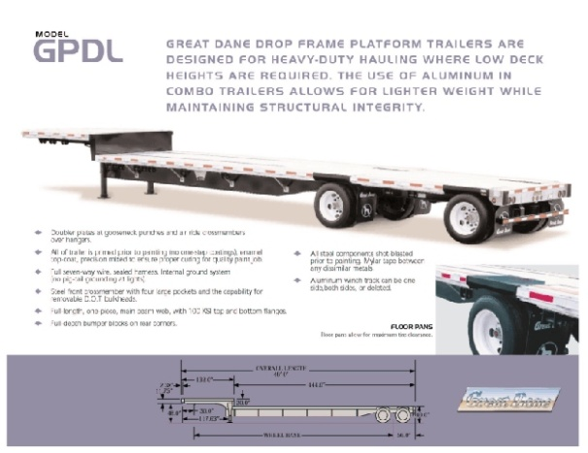
Great Dane Platform
Government Sales
The Work Horses Of The Industry
Great Dane’s Broad Line Of Platform Trailers Are Renowned In The
Industry For The Long List Of Quality Features That Are Exclusive To
Our Manufacturing Process. Customers Can Add Custom Specifications
To Our Standard Models And Adapt The Finished Product To Perform
In Their Unique Environments. Great Dane Trailers Takes Pride In
Offering Platform Trailers That Will Function Precisely Based On The
Your Individual Load And Weight Requirements.

Slide 13
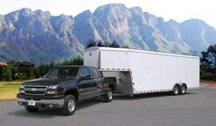
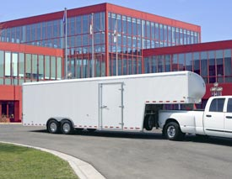
Wells Cargo Gooseneck
Government Sales
Wells Cargo CompacVan® . . . the high cube trailer for 1-ton or mid-size trucks. The Wells Cargo CompacVan® is the largest trailer we build with body lengths up to 48'. When teamed up with a one-ton truck, you've got a rugged combination to tackle the really big jobs. No stranger to hard work, the CompacVan® delivers substantial cubic capacity for high volume loads and GVWR's ranging from 14,700 to 22,500 lbs. Developed specifically for industrial and commercial applications, long lasting durability is engineered from the ground up. The real difference is in the details; reinforcing gussets are all major stress points, weather protected brake wiring, and door hinges with grease zerks. You won't find a longer lasting trailer or one that requires less maintenance . . . period!

Slide 14
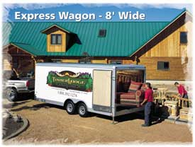
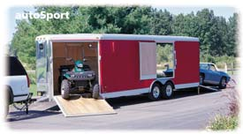
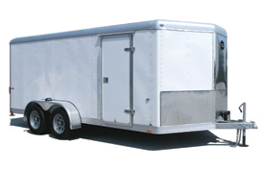
Wells Cargo Enclosed Trailers
Government Sales
Big jobs. You know, the ones that others back away from. Not the rugged Express Wagon®. It was designed specifically for the tough assignments. Extra attention has been given to assure the highest performance and longest service life. Our chassis and frame design are the envy of the industry. We have literally thousands of trailers still in service after 20+ years... that’s more years than most of our competition has been in business! A wide selection of lengths, payloads, and customizing options mean you can find the right trailer for the business at hand. For even more cubic capacity, add the optional Wide Body configuration with a generous 95” interior width. Sometimes bigger is better.

Slide 15
Success Stories
Serving The Industry Since 1990
U.S. Food Service * Mars Supermarkets * Schneider National * United Parcel Service * Vallerie Service Co., LLC * Bee’s Trailer Sales & Service, Inc. * FEMA * All Branches of the United States Military * GSA * DOD * US Border Patrol * All Major Agencies of the Federal Government *
Consolidated Trailers is a key partner with the local and national transportation industry. Since we were incorporated as a non-affiliated, independent parts distributor servicing the Port of Baltimore in 1990, our customer base has evolved to include a mixture of private sector and Government customers. As we grew in experience and established our company as a high quality vendor, our affiliations with major equipment manufacturers also grew and helped to contribute to our overall growth and success.
Most companies would be happy to list any one of these customers as a reference, so we are extremely proud of our customer base and the track record we have built over the past 22 years.

Slide 16
Certifications
Small Business
Veteran Owned Business
SBA HUBZone Certified
CCR Registered (CAGE 1URV4)
Wide Area Work Flow Capable
GSA Contract Holder

